Slide 1
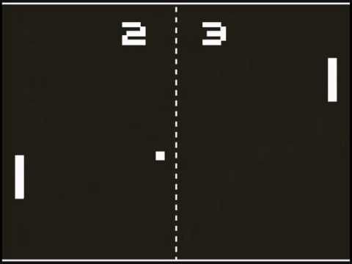
The Classic Two Player Game of Ping Pong
Team:
Abhay Rao(19BCS002)
Abhisek Rana(19BCS003)
Abhishek Arya(19BCS004)
Pranav k M(19BCS088)

Slide 2
Pong: A Brief History
Pong is a table tennis–themed arcade video game, featuring simple two-dimensional graphics, manufactured by Atari and originally released in 1972. It was one of the earliest arcade video games; it was created by Allan Alcorn.
Pong was the first commercially successful video game, and it helped to establish the video game industry along with the Magnavox Odyssey. Soon after its release, several companies began producing games that closely mimicked its gameplay.
Bushnell estimated that the game earned US$35–40 per day, which he described as nothing he'd ever seen before in the coin-operated entertainment industry at the time. The game's earning power resulted in an increase in the number of orders Atari received.

Slide 3
Components Used:-
Arduino Uno R3(32 pins): Arduino Uno is a microcontroller board based on the ATmega328P. It has 14 digital input/output pins (of which 6 can be used as PWM outputs), 6 analog inputs, a 16 MHz ceramic resonator (CSTCE16M0V53-R0), a USB connection, a power jack, an ICSP header and a reset button.
Breadboard: The 170pt breadboard is named for its 170 tie points. It has 17 columns of 10 holes, which are separated into two pairs by a central notch, and labelled 1 to 17.
Pushbutton: The pushbutton is a component that connects two points in a circuit when you press it.
LCD 16X2: The term LCD stands for liquid crystal display. It is one kind of electronic display module used in an extensive range of applications like various circuits & devices like mobile phones, calculators, computers, TV sets, etc.
Resistors: Used to limit the amount of current going to certain components in the circuit.
Peizo: It is a kind of speaker which uses a material that’s piezoelectric, it actually changes shape when you apply electricity to it. By adhering a piezo-electric disc to a thin metal plate, and then applying electricity, we can bend the metal back and forth, which in turn creates noise.

Slide 4
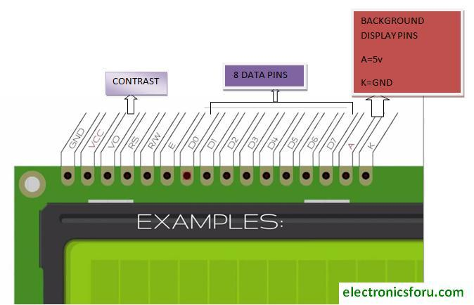
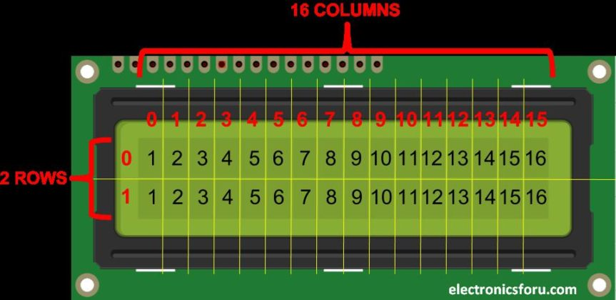
Layout of LCD 16*2:-

Slide 5
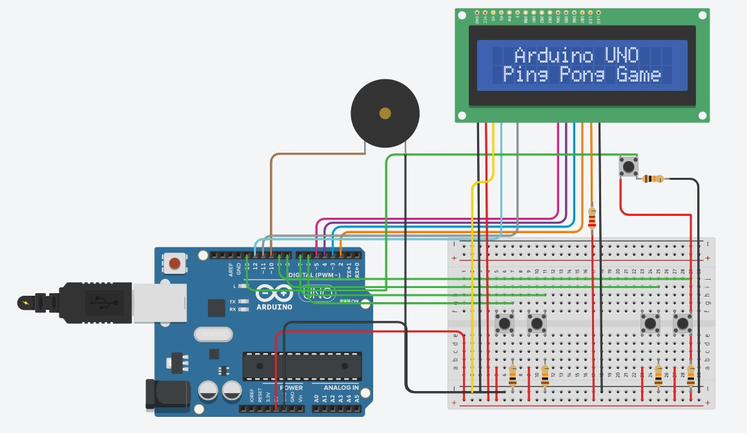
Assembled Circuit

Slide 6
Colour of wires:-
Black: Ground
Red: +5V Power
Green: Pushbutton Input
Brown: Peizo
Others: LCD

Slide 7
Libraries Used:-
LiquidCrystal.h: This library allows an Arduino board to control LiquidCrystal displays (LCDs) based on the Hitachi HD44780 (or a compatible) chipset.
(https://www.arduino.cc/en/Reference/LiquidCrystal)
Adafruit_NeoPixel.h: The Adafruit_NeoPixel() class comprises an object constructor and several methods that provide control over NeoPixel color, brightness, and initialization.
(http://www.seansworld.com/docs/arduino/adafruitReference)

Slide 8
Variables and their use:-
lcd(contains the pixel positions for lcd)
start(Start, pause button)
P1U(Player1 up push button pin)
P1D(Player1 down push button pin)
P2U(Player2 up push button pin)
P2D(Player2 down push button pin)
piezo(piezo electric crystal pin)
paddle1(array to hold paddle1 LCD row-0&1 values)
player11(array to hold paddle1 LCD row-0 values)
player12(array to hold paddle1 LCD row-1 values)
paddle2(array to hold paddle2 LCD row-0&1 values)
player21(array to hold paddle2 LCD row-0 values)
player22(array to hold paddle2 LCD row-1 values)
ball(array to hold ball LCD row-0&1 values)
ball1(array to hold ball LCD row-0 values)
ball2(array to hold ball LCD row-1 values)
x(cursor for ball)
bounce(status of bounce (0- ball moves down, 1- ball moves up))
direction(direction of ball (L- left, R- right))
v1, v2 & v3(variables used to check whether the ball hits the paddles or not)
score1(score of player1), score2(score of player2)
game(start/stop (0- stop, 1- start))

Slide 9
Predefined Functions which are used:-
analogWrite: Writes an analog value (PWM wave) to a pin.
LiquidCrystal: Creates a variable of type LiquidCrystal. The display can be controlled using 4 or 8 data lines. If the former, omit the pin numbers for d0 to d3 and leave those lines unconnected. The RW pin can be tied to ground instead of connected to a pin on the Arduino; if so, omit it from this function's parameters.
Adafruit_NeoPixel: It defines the basic attributes of the NeoPixel element. Once an instance has been instantiated, it can be used to control the behavior of the strip.
lcd.setCursor(x,y): Sets LCD cursor to (x,y).
lcd.createChar: Create a custom character (glyph) for use on the LCD. Up to eight characters of 5x8 pixels are supported (numbered 0 to 7). The appearance of each custom character is specified by an array of eight bytes, one for each row.

Slide 10
User Defined Functions:-
piezoSound: Takes an arguement which is the amount of time(ms) for which the piezo will ring.
Ball moving functions (move the ball depending on its current postion in grid):
ballRightDown(Checks if ball is to hit floor(ball[15]==0), if yes then manages ball for 15 loops(calling ballRight), if no then bounce=1,plays sound)
ballRightUp(Checks if ball is to hit roof(ball[0]==0), if yes then manages ball for 15 loops(calling ballRight) if no then bounce=0,plays sound)
ballRight(assigns values in ball array depending on current value to show ball going right)
ballLeftDown(Checks if ball is to hit floor(ball[15]==0), if yes then manages ball for 15 loops(calling ballLeft), if no then bounce=1,plays sound)
ballLeftUp(Checks if ball is to hit floor(ball[0]==0), if yes then manages ball for 15 loops(calling ballLeft), if no then bounce=0,plays sound)

Slide 11
User Defined Functions:-
ballLeft(assigns values in ball array depending on current value to show ball going left)
Paddle moving functions:-
paddle2Down(If paddle 2 is not already at bottom(paddle2[15]!=16), the values of paddle2 will be updated accordingly).
paddle1Down(If paddle 1 is not already at bottom(paddle2[15]!=1), the values of paddle1 will be updated accordingly).
paddle2Up(If paddle 2 is not already at top(paddle2[0]!=16), the values of paddle2 will be updated accordingly).
paddle1Up(If paddle 2 is not already at top(paddle2[0]!=16), the values of paddle2 will be updated accordingly).

Slide 12
Working:-
There are many arrays such as paddle1, paddle2 and ball, to name a few, which each store the pixel position based on which the user defined functions such as ballRightDown, paddle2Down, and many more, change the position of the ball and paddle.
All these functions work based on the current values within the arrays.
The loop makes sure the user input is taken every time before starting.
The score increases as the players hit the ball and after a win, resets to zero.
The code totals to 328 lines.
The project gives an output of about 25 FPS(Avg).

Slide 13


